Slide 1
Microsoft Edge MemGC Internals
Henry Li,TrendMicro
2015/08/29

Slide 2
Agenda
Background
MemGC Internals
Prevent the UAF'S exploit
Weaknesses of MemGC

Slide 3
Notes
Research is based on Windows 10 10041( edgehtml.dll, chakra.dll)
The latest windows versions( windows 10 10240) data structure there are some small changes

Slide 4
Who am i?
A security research in TrendMicro CDC zero day discovery team.
Four years of experience in vulnerability & exploit research.
Research interests are browser 0day vulnerability analysis, discovery and exploit.
Twitter/Weibo:zenhumany

Slide 5
Background
June 2014 IE introduce ISOLATE HEAP
July 2014 IE introduce DELAY FREE

Slide 6
Background
Isolated Heap can bypass
Delay Free
Pointer to the free block remains on the stack for the entire period of time from the free until the reuse, can prevent UAF EXPLOIT
Other situation, can bypass

Slide 7
What’s MemGC
Chakra GC use Concurrent Mark-Sweep (CMS) Managing Memory
Edge use the same data structures to mange DOM and DOM’S supporting objects, called MemGC

Slide 8
MemGC Internals
Data Structures
Algorithms

Slide 9
MemGC Data Structures
MemProtectHeap
0x000 m_tlsIndex :int
0x108 m_recycler :Recycler
Recycler
0x026c m_HeapBlock32Map HeapBlock32Map
0x42bc m_HeapInfo :HeapInfo
HeapInfo
0x4400 m_HeapBucketGroup[ 0x40] :HeapBucketGroup array
0x5544 m_LargeHeapBucket[ 0x20 ] :LargeHeapBucket array
0x5b44 m_lastLargeHeapBucket :LargeHeapBucket

Slide 10
HeapBucketGroup
HeapBucketGroup 0x154
0x000 m_HeapBucketT<SmallNormalHeapBlock>
0x044 m_HeapBucketT<SmallLeafHeapBlock>
0x080 m_HeapBucketT<SmallFinalizableHeapBlock>
0x0c8 m_HeapBucketT<SmallNormalWithBarrierHeapBlock>
0x10c m_HeapBucketT<SmallFinalizableWithBarrierHeapBlock>

Slide 11
HeapBucketT<SmallNormalHeapBlock>
HeapBucketT<SmallNormalHeapBlock>
0x04 size :int
0x0c m_SmallHeapBlockAllocator
0x20 pPartialReuseHeapBlockList
0x24 pEmptyHeapBlockList
0x28 pFullMarkedHeapBlockList
0x2c pPendingNewHeapBlockList
SmallHeapBlockAllocator<SmallNormalHeapBlock>
0x00 endadderss
0x04 startaddress
0x08 pSmallNormalHeapblock

Slide 12
LargeHeapBucket
LargeHeapBucket
0x04 size
0x0c pSweepLargeHeapBlockList
0x10 pNewLargeHeapBlockList
0x18 pDisposeLargeHeapBlockList
0x1c pPendingLargeHeapBlockList
0x28 pFreeListHead
0x2c pExplicitFreeList

Slide 13
SmallNormalHeapBlock
Attribute Array
SmallNormalHeapBlock
0x04: StartAddress
0x20:pNextSmallHeapblock
0x24: pFreeHeapObject
0x2c: pValidPointersBuffer
0x34: blockSize
0x36: objectCapacity
0x44: pMarkBitMapTable
0x48: freeBitVector
0 | 1 | 2 | 3 | 4 | 5 | 6 | 7 | 8 | 9 | a | b | c | d | e | f
10 | 11 | 12 | 13 | 14 | 15 | 16 | 17 | 18 | 19 | 1a | 1b | 1c | 1d | 1e | 1f

Slide 14
LargeHeapBlock
LargeHeapBlock
0x04 pageAddress
0x28 allocblockcount
0x2c blockCapacity
0x30 allocAddress
0x34 endAddress
0x38 pNextLargeHeapBlock
0x44 pPrevFreeList
0x48 pNextFreeList
0x4c pFreeHeapObject
0x64 allocBlockAddressArray[]
0 | 1 | 2 | … | blockCapacity-1

Slide 15
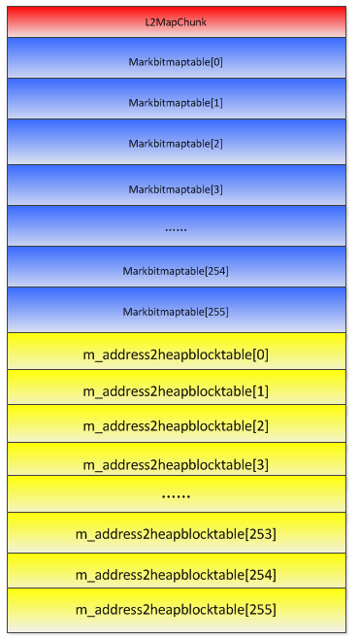
HeapBlock32Map
HeapBlock32Map
0x00 count
0x04 m_pL2MapChunkArray[4096]
L2MapChunk
0x0000 markbitmaptable[256]
0x2000 m_address2heapblocktable[256]

Slide 16
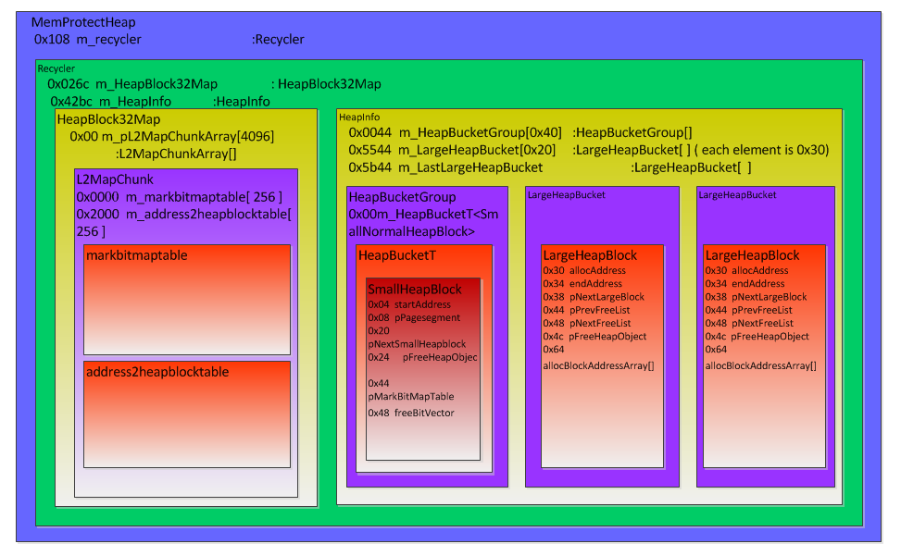
OVERVIEW

Slide 17
Algorithms
Alloc
Free
Mark
Sweep

Slide 18
MemGC Alloc
edgehtml!MemoryProtection::HeapAlloc<1>
edgehtml!MemoryProtection::CMemoryGC::ProtectedAlloc<3>
chakra! MemProtectHeapRootAlloc
chakra!Recycler::NoThrowAllocImplicitRoot

Slide 19
Alloc
(0x00-0x400]—HeapBucketGroup
array size: 0x400/0x10 = 0x40
(0x400-0x2400]—LargeHeapBucket
array size: 0x2000/0x100 = 0x20
(0x2400-)—LargeHeapBucket
size: 0x01

Slide 20
MemGC Alloc
size | HeapBucket address
0x10 | m_HeapBucketGroup[0x00]
0x20 | m_HeapBucketGroup[0x10]
0x30 | m_HeapBucketGroup[0x20]
…… | ……
0x390 | m_HeapBucketGroup[0x38]
0x400 | m_HeapBucketGroup[0x39]
0x500 | m_LargeHeapBucket[0x00]
0x600 | m_LargeHeapBucket[0x01]
…… | ……
0x2300 | m_LargeHeapBucket[0x18]
0x2400 | m_LargeHeapBucket[0x19]
>0x2400 | m_LastLargeHeapBucket

Slide 21
HeapBucketT<SmallNormalHeapBlock>
HeapBucketT<SmallNormalHeapBlock>
0x00 pHeapInfo
0x04 size
0x0c m_SmallHeapBlockAllocator 0x00 endaddress 0x04 startaddress 0x08 pSmallNormalHeapBlock
0x20 pPartialReuseHeapBlockList
1、startaddress + blocksize <= endaddress
return startaddress
2、HeapBucketT::SnailAlloc
pPartialReuseHeapBlockList !=null;
alloc from pPartialReuseHeapBlockList
3、New SmallNormalHeapBlock

Slide 22
LargeHeapBucket
LargeHeapBucket
0x00 pHeapInfo
0x04 size
0x10 pNewLargeHeapBlockList
0x28 pFreeListHead
0x2c pExplicitFreeList
1、pNewLargeHeapBlockList
2、pExplicitFreeList, pFreeListHead
3、New LargeHeapBlock

Slide 23
Alloction Recycler::NoThrowAllocImplicitRoot( int size )
NoThrowAllocImplicitRoot:Part I
Align the size to 0x10
Size <= 0x400, go into small heap object alloc
HeapInfo* pHeapInfo = &(this->m_HeapInfo); Recycler* pRecycler = this->pRecycler; //Adjust the size to 0x10 bytes align. int align_size = (size + 15) & 0xfffffff0; //size <= 0x400,go into small heap if( size <= 0x400) { //Get the HeapBucketGroup index in the HeapInfo->m_HeapBucketGroup int index = align_size / 16; //Get the SmallNormalHeapBlock type HeapBucketT HeapBucketT<SmallNormalHeapBlock>* pHeapBucketT = &pHeapInfo->m_HeapBucketGroup[ index ].m_HeapBucketT<SmallNormalHeapBlock>; //Get SmallHeapBlockAllocator SmallHeapBlockAllocator* pSmallHeapBlockAllocator = pHeapBucketT->pSmallHeapBlockAllocatorT; //Get pSmallNormalHeapBlock SmallNormalHeapBlock* pSmallNormalHeapBlock = pSmallHeapBlockAllocator->pSmallHeapBlock ; //if startAddress + align_size > endAddress,go into SnailAlloc or if (pSmallHeapBlockAllocator->startAddress + align_size <= pSmallHeapBlockAllocator->endAddress) { //startAddress + align_size <= endAddress, return the startAddress allocAddress = pHeapBucketT->startAddress; //update the startAddress of pSmallHeapBlockAllocator equal startAddress + align_size pSmallHeapBlockAllocator->startAddress = pHeapBucketT->startAddress + align_size; if( pSmallHeapBlockAllocator->NeedSetAttributes( 8 )) { pSmallNormalHeapBlock->SetAttribute(pHeapBucketT, 8); } return allocAddress; }

Slide 24
NoThrowAllocImplicitRoot:Part I
Goto snailalloc or reuse freeobject
//if startAddress + align_size > endAddress,go into SnailAlloc or else { //startAddress==0 or endAddress!=0 ,gointo SnailAlloc if( pSmallHeapBlockAllocator->startAddress ==0 || pSmallHeapBlockAllocator->endAddress!=0 ) { allocAddress = pHeapBucketT->SnailAlloc(pRecycler, pSmallHeapBlockAllocator, align_size, 8, 1); if( allocAddress == 0) return 0; else *allocAddress = 0; return allocAddress } if( pSmallHeapBlockAllocator->NeedSetAttributes( 8 )) { pSmallNormalHeapBlock->SetAttribute(pHeapBucketT, 8); } //startAddress !=0 &&endAddress==0, we can reuse the free heap object //free heap object first dword is a pointer which pointer to the next heap object. allocAddress = pSmallHeapBlockAllocator->startAddress; //startAddress to the next heap object pSmallHeapBlockAllocator->startAddress = (*pSmallHeapBlockAllocator->startAddress) & 0xffffffe; return allocAddress; }

Slide 25
NoThrowAllocImplicitRoot:Part II
Alloc middle object
else if( size <= 0x2400 ) //size in (0x400,0x2400],进入LargeHeapBucket进行分配 { //Calculate largeheapbucket index in HeapInfo.m_LargeHeapBucket int largebucketIndex = ( align_size - 1025 ) / 256 ; //Get LargeHeapBucket LargeHeapBucket* pLargeHeapBucket = &pHeapInfo->m_LargeHeapBucket[ largebucketIndex]; //Get pLargeHeapBlockList pLargeHeapBlock = pLargeHeapBucket->pLargeHeapBlockList; //pLargeHeapBlockList not zero, go into LargeHeapBlock::Alloc if(pLargeHeapBlock) { allocAddress = pLargeHeapBlock ->Alloc( align_size, 8) if( allocAddress) { *allocAddress = 0; return allocAddress; } } //pLargeHeapBlockList is zero, check freelistflag,if true, to alloc from freelsit else if( pLargeHeapBucket-> freelistflag) { allocAddress = pLargeHeapBucket->TryAllocFromExplicitFreeList(pLargeHeapBucket, (int)v2, v12, 8u); if( allocAddress || allocAddress = pLargeHeapBucket->TryAllocFromFreeList( )!=0 ) return allocAddress; } //if above two step alloc fail, go into LargeHeapBucket::SnailAlloc pLargeHeapBucket->SnailAlloc(pRecycler, align_size, 8, 1); }

Slide 26
NoThrowAllocImplicitRoot:Part III
Alloc large object
else //size > 0x2400,go into Recycler::LargeAlloc { allocAddress = Recycler::LargeAlloc( pHeapInfo, size, 8 ) *allocAddress = 0; return allocAddress; }

Slide 27
HeapBucketT<SmallNormalHeapBlock>::SnailAlloc Part I
//SmallHeapBlockAllocator<SmallNormalHeapBlock>::Clear( ) pSmallHeapBlockAllocator->clear( ); //get reuse smallheapblock SmallHeapBlock* pFreeListHeapBlock = this->pFreeListHeapBlock; //pFreeListHeapBlock not zero, go into reuse the heapblock if(pFreeListHeapBlock ) { //set the pFreeListHeapBlock to the NextSmallHeapBlock this->pFreeListHeapBlock = pFreeListHeapBlock->pNextSmallHeapBlock; pFreeListHeapBlock->markFlag = 1; //set SmallHeapBlockAllocator::pSmallHeapblock pointer pFreeListHeapBlock pSmallHeapBlockAllocator->pSmallHeapBlock = pFreeListHeapBlock; //beginAddress point to the reuse heapblock pFreeHeapObject pSmallHeapBlockAllocator->beginAddress = pFreeListHeapBlock->pFreeHeapObject; }

Slide 28
HeapBucketT<SmallNormalHeapBlock>::SnailAlloc Part II
//Get HeapBlockMap32 HeapBlockMap32* pHeapBlockMap32 = &pRecycler->m_HeapBlockMap32; //initial SmallNormalHeapBlock pSmallNormalHeap-> pPageSegment = pageSegment pSmallNormalHeap-> startAddress = pageaddress; int first_index = (pageaddress /2^20) int second_index = (pageaddress / 2^12) & 0xff; pL2MapChunk = pHeapBlockMap32->m_pL2MapChunkArray[ first_index ]; //map the pageaddress and SmallHeapBlock relation pL2MapChunk->Set(second_index, 1, pSmallHeapBlock); //Get markbitmaptable to initial SmallNormalHeapBlock::pMarkBitMap markbitmaptable = pL2MapChunk->m_markbitmaptable[ second_index ]; pSmallHeapBlock->pMarkBitMap = markbitmaptable; //add the new SmallNormalHeapBlock into Recycelr-> pSmallNormalHeapBlockList list pSmallHeapBlock-> pNextSmallHeapblock = pRecycler-> pSmallNormalHeapBlockList; pRecycler-> pSmallNormalHeapBlockList = pSmallHeapBlock; pSmallHeapBlock-> markflag = 1; //Initial pSmallHeapBlockAllocator pSmallHeapBlockAllocator->pSmallHeapBlock = pSmallHeapBlock; pSmallHeapBlockAllocator->startAddress = pSmallHeapBlock->startAddress; pSmallHeapBlockAllocator->endAddress = pSmallHeapBlock->startAddress + 0x1000; …… return pageaddress;

Slide 29
LargeHeapBucket::AddLargeHeapBlock Part I
LargeHeapBlock* LargeHeapBucket::AddLargeHeapBlock(int blockSize, bool param4) { int freelistflag = this->freelistflag; int memoryCapacity =0; struct Segment *pSegment = null; HeapInfo* pHeapInfo = this->pHeapInfo; Recycler* pRecycler = pHeapInfo->pRecycler; if( freelistflag == 0) memoryCapacity = 4* blockSize; //memoryCapacity + 16 >= memoryCapacity check int overflow if( memoryCapacity + 16 >= memoryCapacity ) { //culation requires allocation of pages int pagenum =( memoryCapacity + 0xfff)>>12; //select pageallocator RecyclerPageAllocator* pRecyclerPageAllocator = &pRecycler->m_RecyclerPageAllocator[2]; //alloc pages int pageaddress = pRecyclerPageAllocator->AllocInternal( pagenums, &pSegment); //Calculate the pages contains how may blocks int blocksNum =(((pagenums<<12) - blockSize - 16 ) >>10 ) + 1; //largeheapblock size is 0x64 add blocksNum*4 int largeheapblockSize = 0x64 + blocksNum*4; //alloc LargeHeapBlock LargeHeapBlock* pLargeHeapblock = (LargeHeapBlock*)HeapAllocator::NoThrowAllocZero(largeheapblockSize );

Slide 30
LargeHeapBucket::AddLargeHeapBlock Part II
if( pLargeHeapBlock) { pLargeHeapBlock->pLargeHeapBucket = this; pLargeHeapBlock->pagenum = pagenum; pLargeHeapBlock->blockCapacity = blocksNum; pLargeHeapBlock->allocAddress = pageaddress; pLargeHeapBlock->largeHeapType = 0x05; pLargeHeapBlock->pNextLargeHeapBlock = pLargeHeapBlock; pLargeHeapblock->pPageSegment = pSegment; pLargeHeapblock->pageAddress = pageaddress; pLargeHeapblock->unknown = 0; pLargeHeapblock->endaddress = pageaddress + pagenum<<12; pRecycler->pageCount += pagenum; pLargeHeapblock ->pHeapInfo = pHeapInfo; *(pLargeHeapBlock+0x54) = 0; bool result = pRecycler->m_HeapBlockMap32.SetHeapBlock( pageaddress,pagenum,pLargeHeapBlock ); if(result) { //link the new LargeHeapBlock to the pLargeHeapBucket->pLargeHeapBlockList list pLargeHeapblock->pNextLargeBlock = pLargeHeapBucket->pLargeHeapBlockList; pLargeHeapBucket->pLargeHeapBlockList = pLargeHeapblock; return pLargeHeapblock; } }

Slide 31
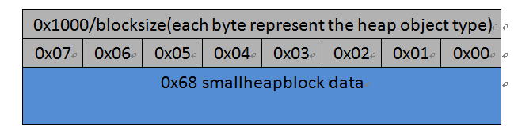
SmallNormalHeapBlock
Size = 0x68 + ((0x1000/blocksize) +3 )&0x0FFFFFFFC

Slide 32
SmallNormalHeapBlock
Attribute Array
blockSize
blockSize
blockSize
SmallNormalHeapBlock
0x04: StartAddress
0x20:pNextSmallHeapblock
0x24: pFreeHeapObject
0x2c: pValidPointersBuffer
0x34: blockSize
0x36: objectCapacity
0x44: pMarkBitMapTable
0x48: freeBitVector
0 | 1 | 2 | 3 | 4 | 5 | 6 | 7 | 8 | 9 | a | b | c | d | e | f
10 | 11 | 12 | 13 | 14 | 15 | 16 | 17 | 18 | 19 | 1a | 1b | 1c | 1d | 1e | 1f
……
……
……
blockSize
blockSize
blockSize
HeapInfo::ValidPointersMap::validPointersBuffer
0 | 1 | 2 | …… | fe | ff
100 | 101 | 102 | …… | 1fe | 1ff
L2MapChunk
0 | 1 | 2 | 3 | 4 | 5 | 6 | 7 | 8 | 9 | a | b | c | d | e | f
10 | 11 | 12 | 13 | 14 | 15 | 16 | 17 | 18 | 19 | 1a | 1b | 1c | 1d | 1e | 1f

Slide 33
Markbitmap,freeBitvector
SmallHeapBlock managers one page( 4k)Memory.
2^12/2^4=256
markbitmap 32 bytes, 256 bit.
bit 1: mark
bit 0: unmark
freeBitVector 32 bytes, 256 bit.
bit 1: free
bit 0: unfree

Slide 34
validPointersBuffer
Each SmallHeapBlock mangers one page(4k) memory
2^12/2^4=256
ValidPointer: the beginaddres of the object is Valid pointer, the interior address is invalid pointer.
Each validPointersBuffer element contains two part, each part is an array,array length is 256.
First part: Chakra GC
Second part: MemGc

Slide 35
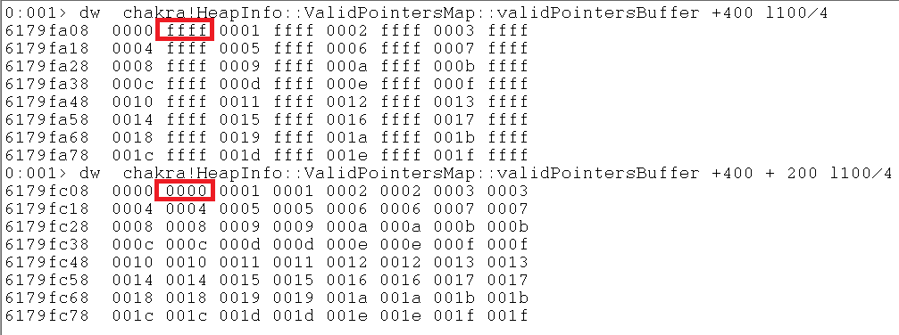
HeapInfo::ValidPointersMap::validPointersBuffer
SmallNormalHeapBlock blocksize 0x20 pageaddress 0x15100000

Slide 36
validPointersBuffer example
15100000,15100020,15100040……
15100010
Chakra GC:
index = validPointerBuffer_chakra[(address – pageaddress)/0x10] = 0xffff
MemGC
Index = validPointerBuffer_memgc[(address – pageaddress)/0x10] = 0x00
Realaddress = pageaddress + index*blocksize = 0x15100000

Slide 37
LargeHeapBlock
pagenums = ((blocksize*4 + 10 ) + 0xfff)/2^12
arrayLength = ( (pagenums*2^12) – blocksize -0x10)/2^10 +1
largeheapblockSize = 0x64 + 4*arrayLength

Slide 38
LargeHeapBlock
blockSize+0x10
blockSize+0x10
blockSize+0x10
LargeHeapBlock
0x04 pageAddress
0x28 allocblockcount
0x2c blockCapacity
0x30 allocAddress
0x34 endAddress
0x38 pNextLargeHeapBlock
0x44 pPrevFreeList
0x48 pNextFreeList
0x4c pFreeHeapObject
0x64 allocBlockAddressArray[]
0 | 1 | 2 | … | blockCapacity-1
……
……
……
blockSize+0x10
blockSize+0x10
blockSize+0x10

Slide 39
LargeObjectHeader
LargeObjectHeader( inuse )
0x00 index
0x04 blocksize
0x08 initialzero
0x0c encode
LargeObjectHeader( free)
0x00 index
0x04 blocksize
0x08 pLargeHeapBlock
0x0c pNextFreeHeapObject

Slide 40
pageaddress to HeapBlock
pageaddres
High 12 bit: first_index
Middle 8 bit: second_index
Low 12 bit: not used
31 | 30 | 29 | 28 | 27 | 26 | 25 | 24 | 23 | 22 | 21 | 20 | 19 | 18 | 17 | 16 | 15 | 14 | 13 | 12 | 11 | 10 | 9 | 8 | 7 | 6 | 5 | 4 | 3 | 2 | 1 | 0

Slide 41
HeapBlock32Map
HeapBlock32Map
0x00 count
0x04 m_pL2MapChunkArray[4096]
count: the number of L2MapChunk in m_pL2MapChunkArray
m_pL2MapChunkArray: an L2MapChunk array.
L2MapChunk
0x0000 markbitmaptable[256]
0x2000 m_address2heapblocktable[256]
markbitmaptable: markbitmap array. each element 32 bytes
m_address2heapblocktable : an array, each element is an pointer to HeapBlock

Slide 42
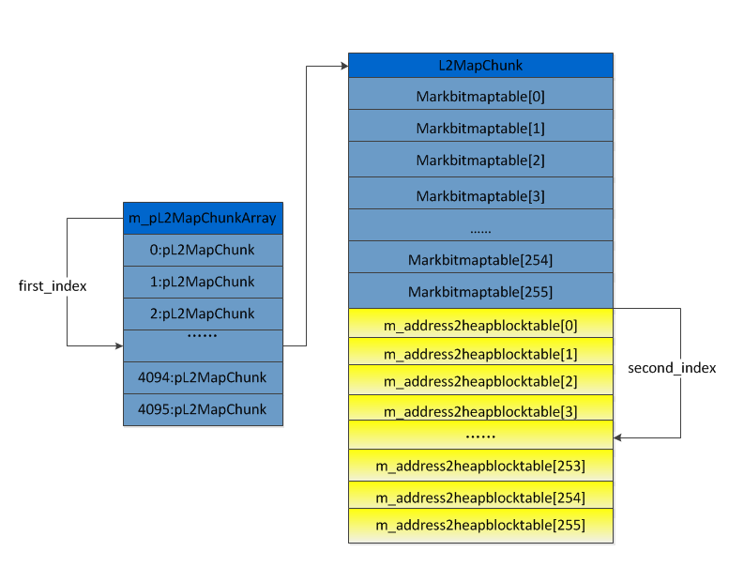
pageaddress to HeapBlock

Slide 43
MemGC Free
edgehtml! MemoryProtection::HeapFree
Edgehtml!MemoryProtection::CMemoryGC::ProtectedFree
chakra!MemProtectHeapUnrootAndZero

Slide 44
MemProtectHeapUnrootAndZero
1、memset zero
2、unroot
MemProtectHeapUnrootAndZero(MemProtectHeap* pMemProtectHeap, void* freeBlockAddress) { MemProtectThreadContext* pMemProtectThreadContext = TlsGetValue( pMemProtectHeap->m_tlsIndex); RecyclerHeapObjectInfo tempRecyclerHeapObjectInf; if( pMemProtectThreadContext ) { *(_BYTE*)(pMemProtectThreadContext+8) = 1; MemProtectHeap* pMemProtectHeapFromContext = pMemProtectThreadContext->pMemProtectHeap; Recycler* pRecycler = &(pMemProtectHeapFromContext->m_Recycler); if(pRecycler->FindHeapObject( freeblockAddress,2, &tempRecyclerHeapObjectInf )) { if( !tempRecyclerHeapObjectInf.IsLeaf( )) { int objectsize = tempRecyclerHeapObjectInf.pHeapBlock->GetObjectSize( ); //set the freeblockaddress content zero memset( freeBlockAddress, 0, objectsize); } if(tempRecyclerHeapObjectInf.ClearImplictRootbit( )) { pMemProtectThreadContext->NotifyUnroot( &RecyclerHeapObjectInfo); } } } }

Slide 45
Mark
chakra!markcontext
0x08 stackpointer
0x0c basepointer
0x10 endAddress
0x14 arrayStartAddress
stackpointer: the stack current element address.
basepointer: the stack begin address
endAddress: the stack endaddress
arrayStartAddress : the begin address which maintance the stack information.

Slide 46
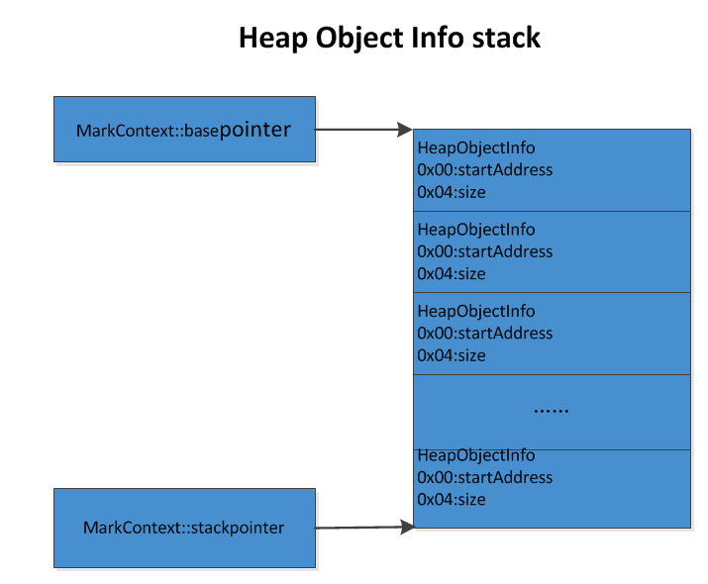
Mark

Slide 47
find roots
MemProtectHeap::FindRoots
MemProtectThreadContext::ScanStack
Recycler::ScanImplicitRoots
push the root object into makecontext.

Slide 48
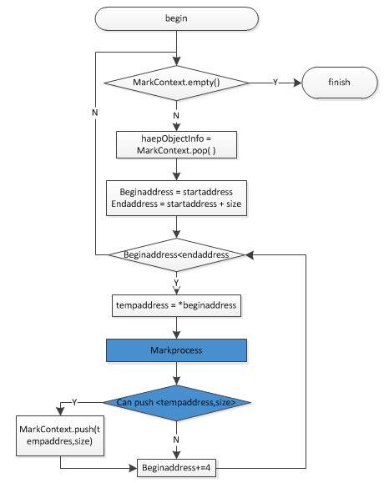
processmarkcontext

Slide 49
Address mark
Address > 0x10000
Address -> HeapBlock
realaddress = GetRealAddressFromInterior
LargeHeapBlock:: GetRealAddressFromInterior
SmallHeapBlock::GetRealAddressFromInterior

Slide 50
address mark
Addres
High 12 bit: first_index
Middle 8 bit: second_index
Low 8 bit: bit_index
Last low 4 bit: 0x10 bytes alignment
31 | 30 | 29 | 28 | 27 | 26 | 25 | 24 | 23 | 22 | 21 | 20 | 19 | 18 | 17 | 16 | 15 | 14 | 13 | 12 | 11 | 10 | 9 | 8 | 7 | 6 | 5 | 4 | 3 | 2 | 1 | 0

Slide 51
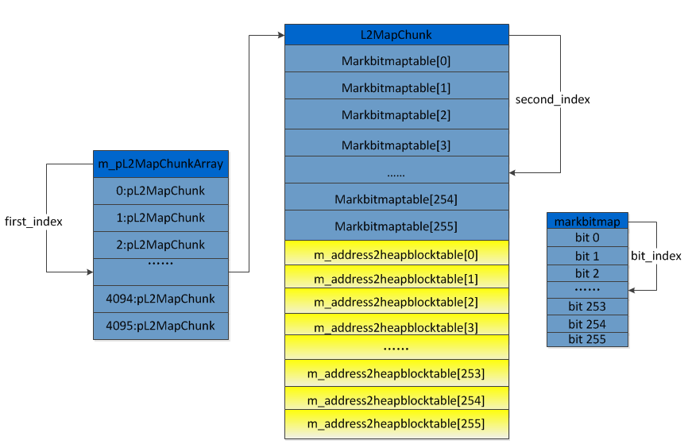
address mark

Slide 52
push (address,size) to stack
The address is the first time mark
Address -> HeapBlock
SmallNormalHeapBlock::ProcessMarkedObject
LargeHeapBlock::Mark

Slide 53
SmallNormalHeapBlock::ProcessMarkedObject
chakra!SmallNormalHeapBlock::ProcessMarkedObject(SmallHeapBlock* pSmallHeapBlock, int address, MarkContext* pMarkContext) { int blockSize = this->blockSize; BYTE bit_index = (address>>4) &0xff int invalidBitsIndex = blockSize/0x10; //32 bytes invalidBits = HeapInfo::ValidPointersMap:: invalidBitsData[ invalidBitsIndex ]; //1,invalid,0 valid if(!bittest( invalidBits, bit_index )) { if( pMarkContext->stackpointer != pMarkContext->arrayEndAddress) { //push one element into the stack. stackpointer = pMarkContext->stackpointer; *stackpointer = address; *(currentAddress+4) = blockSize; pMarkContext->stackpointer +=8; } } }

Slide 54
invalidBitsData
each smallheapblock manager one page memory(4k)
2^12/2^4 = 256
Each invalidBitsData element is 32 bytes, 256 bit , each bit indicates whether the address is a valid pointer
bit 1: invalid pointer
bit 0: valid pointer

Slide 55
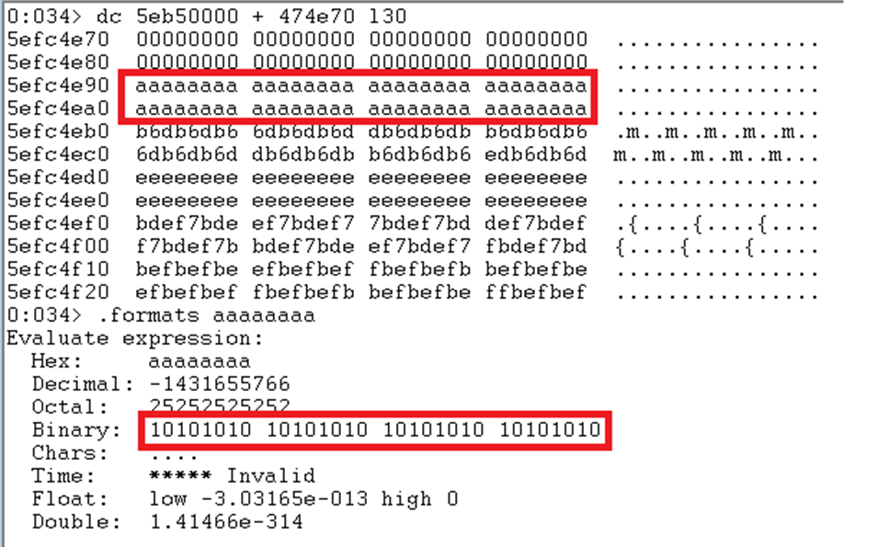
HeapInfo::ValidPointersMap::invalidBitsData
blocksize 0x20

Slide 56
LargeHeapBlock::Mark
chakra!LargeHeapBlock::Mark( int address, MarkContext* pMarkContext) { //get the largeobjectheader LargeObjectHeader* pLargeObjectHeader = (LargeObjectHeader*)(address-0x10) //check the object is a valid object //one: address-0x10 > LargeHeapblock::pageaddress //two: LargeObjectHeader::index < LargeHeapblock::allocblockcount //three: address-0x10 == allocBlockAddressArray[pLargeObjectHeader->index] if(pLargeObjectHeader >= this->pageaddress && pLargeObjectHeader->index <this->allocblockcount && this->allocBlockAddressArray[pLargeObjectHeader->index] == pLargeObjectHeader) { //push one object info into stack. stackpointer = pMarkContext->stackpointer; *strackpointer = address; *(stackpointer+4) = pLargeObjectHeader->blockSize; pMarkContext->stackpointer +=8; } }

Slide 57
HeapInfo::Sweep<0>
HeapInfo::Sweep<0>( RecyclerSweep* pRecyclerSweep, bool flag) { for( var i=0;i<0x40;i++) { HeapBucketGroup pHeapBucketGroup = &this->m_HeapBucketGroup[i]; SmallFinalizableHeapBucketT<SmallFinalizableHeapBlock>* pHeapBucket = &pHeapBucketGroup->m_HeapBucketT<SmallFinalizableHeapBlock>; pHeapBucket->Sweep0( pRecyclerSweep ); SmallFinalizableHeapBucketT<SmallFinalizableWithBarrierHeapBlock>* pHeapBucket = &pHeapBucketGroup->m_HeapBucketT<SmallFinalizableWithBarrierHeapBlock>; pHeapBucket->Sweep0( pRecyclerSweep ); } this->SweepSmallNonFinalizable<0>(pRecyclerSweep); for( var i=0;i<0x20;i++) { LargeHeapBucket* pLargeHeapBucket = &this->m_LargeHeapBucket[i]; pLargeHeapBucket->Sweep<0>( pRecyclerSweep); } this->m_LastLargeHeapBucket.Sweep<0>( pRecyclerSweep); }

Slide 58
HeapBucketT<SmallNormalHeapBlock>
HeapBucketT<SmallNormalHeapBlock>
0x20 pPartialReuseHeapBlockList
0x24 pEmptyHeapBlockList
0x28 pFullMarkedHeapBlockList
0x2c pPendingNewHeapBlockList

Slide 59
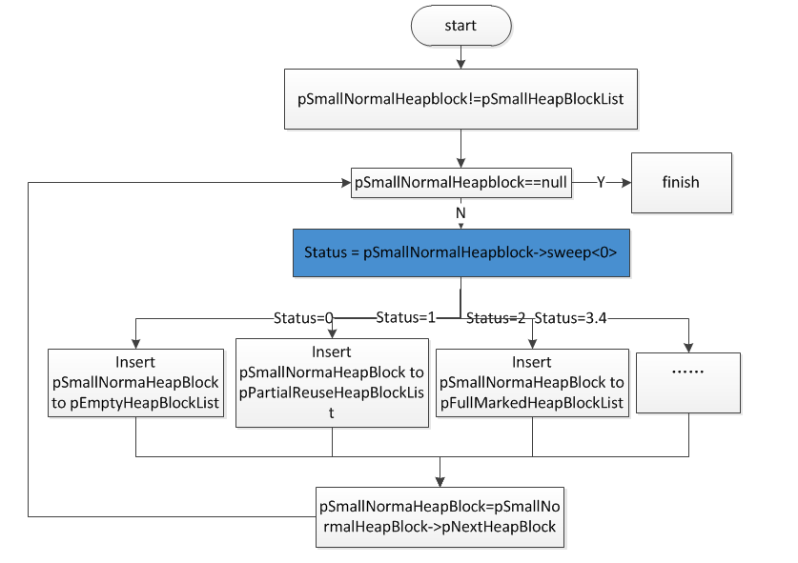
SweepSmallHeapBlock

Slide 60
SmallHeapBlock::sweep<0>
return status
0: no object marked
1 : partial object marked
2 : all object marked
3: never come here
4: some pending heapblock

Slide 61
SmallHeapBlock::Sweep<0>
1、Calculation freecount
2、Calculation markcount
3、Sweepcount = objectCapacity – markcount- freecount

Slide 62
SmallHeapBlock::Sweep<0>: Part I
SmallHeapBlock::Sweep<0>(RecyclerSweep *pRecyclerSweep,pendingflag,flag,pSmallHeapBlock->unknowncount,flagDispose ) { if(flag) { //if pFreeHeapObject ！= pLatestSweepFreeHeapObject, after the last sweep, some free object alloced //need if(this->pFreeHeapObject != this->pLatestSweepFreeHeapObject) { this->freeobjectCount = this->BuildFreeBitVector( this->pFinalizeBitMap); this->pLatestSweepFreeHeapObject = this->pFreeHeapObject; } pRecycler = *pRecyclerSweep; if(*(pRecyler->bPartialCollectMode) { int freeblock =this->freeobjectCount; int lastSweepfreeblock = this->lastetSweepfreeblockCount; int blockSize = this->blockSize; int sub = lastSweepfreeblock - freeblock; int subtotal = sub*blockSize; this->lastetSweepfreeblockCount = this->freeobjectCount; * (pRecyclerSweep + 0x1424) +=aa; *(pRecycler + b5c0) += aa; } else { //update lastetSweepfreeblockCount this->lastetSweepfreeblockCount= this->freeobjectCount; this->freeblock3e = this->freeobjectCount; } }

Slide 63
SmallHeapBlock::Sweep<0>: Part II
if( this->freeobjectCount) { pMarkBitMapTable = this->pMarkBitMapTable; pMarkBitMapTableEnd = pMarkBitMapTable+32; pTemp=pMarkBitMapTable; pFreeBitVector = &this->freeBitVector //Recalculated markbittable do( *pTemp =*pTemp & ( ~*(pFreeBitVector +pTemp-pMarkBitMapTable ) ); pTemp += 4; )while( pTemp !=pMarkBitMapTableEnd ) }

Slide 64
SmallHeapBlock::Sweep<0>: Part III
blockSize = this->blockSize; pinvalidBitsData = chakra!HeapInfo::ValidPointersMap::invalidBitsData; pInvalidBitsDataBegin = pinvalidBitsData+32*( blockSize>>4); pMarkBitMapTable = this->pMarkBitMapTable; pMarkBitMapTableEnd = pMarkBitMapTable+32; //Recalculated markbittable for(; pMarkBitMapTable!=pMarkBitMapTableEnd;pMarkBitMapTable+=4) { int value = *pInvalidBitsDataBegin; pInvalidBitsDataBegin+=4; *pMarkBitMapTable= *pMarkBitMapTable&(~*value); }

Slide 65
SmallHeapBlock::Sweep<0>: Part IV
int markcount = 0; pMarkBitMapTable = this->pMarkBitMapTable; //Calculation mark object number for(int i=0;i<8;i++) { markcount +=BVUnitT<unsigned_int>::CountBit(pMarkBitMapTable + 4*i ); }

Slide 66
SmallHeapBlock::Sweep<0>: Part V
if( pendingDisposeCount || markcount!=0) { result = 1; LABEL_25: //have dispose object, return 3. if( flagDispose) result = 3; if( unmark) { if(pendingflag) { *(pRecyclerSweep+0x141a) = 1; result = 4; this->0x0e = 1; return result; } this->SweepObjects<0>(* pRecyclerSweep); if( this->IsIsAnyFinalizableBlock()&& (this->0x6aunknownDispose1)) return 3; } else //all object marked, return 2 if(!freeblock) return 2; return result; } if( flagDispose) goto Label_25: return 0; }

Slide 67
Calculation markcount
markbitmap
&~
invalidBitsData
&~
freebitvector
=
New markbitmap

Slide 68
Why need invalidBitsData, freebitvector
MemGC is a Conservative GC, does not distinguish between data and pointers.
X is a data manager by MemGC
X.value == freeobjectA.address or X.value == InvalidPointer
In MemGC mark phase, it will mark the address(x.value).

Slide 69
Sweepcount!=0
sweepcount= objectCapacity - freeCount-markcount

Slide 70
SmallHeapBlock::SweepObjects I
SmallHeapBlock：：SweepObjects<0>(Recycler* pRecycler) { startaddress = this->startaddress; pMarkBitMapTable = pSmallHeapBlock->pMarkBitMapTable ; blockCount = this->blockCount( 0x34) blocksize = this->blocksize ( 0x36) tyeparray= (*BYTE)this-1; vartype = *typearray tempaddress = startaddress freeBitVector = pSmallHeapBlock->freeBitVector //while( ) process each object in the SmallHeapBlock where(blockcount--) { //tempaddress unmarked if(tempaddress unmark in pMarkBitMapTable and tempaddress unkmark in freeBitVector)// check in Bitmapaddress) { //vartype not implict root if(vartype & 0x80 ==0) { //link the tempaddress into the freeheapobject list pFreeHeapObject = this->pFreeHeapObject; pFreeHeapObject = pFreeHeapObject | 1; *tempaddress = pFreeHeapObject; this->pFreeHeapObject = tempaddress; *typearray = 0; }

Slide 71
pFreeHeapObject
SmallNormalHeapBlock
0x24: pFreeHeapObject
0x00:pNextHeapObject
0x00:pNextHeapObject
0x00:pNextHeapObject
0x00:pNextHeapObject

Slide 72
SmallHeapBlock mark-sweep example
PageAddress: 0x15000000
0x00000000
0x15000001
0x15000301
0x15000401
0x15000501
0x15000801
0x15000b01
0x15000c01
0x15000801
0x15000401
0x15000b01
0x15000301
0x15000001
0x15000f01
0x15000c01
0x15000501

Slide 73
LargeHeapBucket::Sweep<0>
LargeHeapBucket::Sweep<0>(RecyclerSweep* pRecyclerSweep) { LargeHeapBlock* pNewLargeHeapBlockList,pSweepLargeHeapBlockList,pUnknown1,pDisposeLargeHeapBlockList; pNewLargeHeapBlockList = this->pNewLargeHeapBlockList; pSweepLargeHeapBlockList = this->pSweepLargeHeapBlockList; //pUnknown1 always null. pUnknown1 = this->pUnknown1; pDisposeLargeHeapBlockList = this->pDisposeLargeHeapBlockList; this->pNewLargeHeapBlockList =0; this->pSweepLargeHeapBlockList =0; this->pUnknown1 = 0; if( this->freelistflag) { this->pExplicitFreeListHead = 0; this->pFreeListHead = 0; } //sweep pNewLargeHeapBlockList, pSweepLargeHeapBlockList, pUnknown1,pDisposeLargeHeapBlockList list. this->SweepLargeHeapBlockList<0>(pRecyclerSweep,pNewLargeHeapBlockList ); this->SweepLargeHeapBlockList<0>(pRecyclerSweep,pSweepLargeHeapBlockList ); this->SweepLargeHeapBlockList<0>(pRecyclerSweep,pUnknown1 ); this->SweepLargeHeapBlockList<0>(pRecyclerSweep,pDisposeLargeHeapBlockList ); }

Slide 74
LargeHeapBucket
LargeHeapBucket
0x0c pSweepLargeHeapBlockList
0x10 pNewLargeHeapBlockList
0x14 pUnknown1
0x18 pDisposeLargeHeapBlockList
0x1c pPendingLargeHeapBlockList

Slide 75
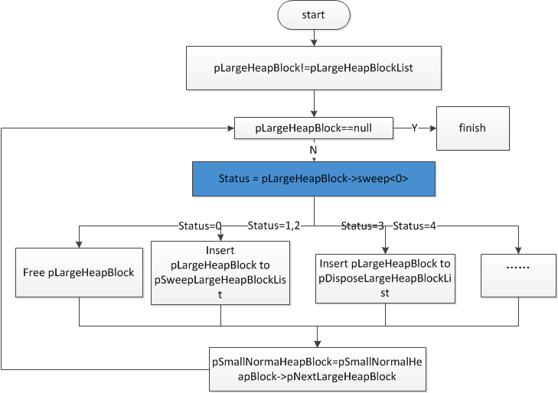
SweepLargeHeapBlock

Slide 76
LargeHeapBlock::Sweep<0>
Return status
0: no object marked
1 : partial object marked
2 : all object marked
3: never come here
4: some pending heapblock

Slide 77
LargeHeapBlock::Sweep<0>
calculation markcount

Slide 78
LargeHeapBlock::Sweep<0>
int LargeHeapBlock::Sweep<0>( ) { int result; //Calculate marked object number in the LargeHeapBlock int markCount = this->GetMarkCount( ); //markcount==0 && this->sweepFlag==0, return zero, It indicates that the memory in the largeheapBlock can be released if( markCount ==0 && this->sweepFlag==0) { Recycler::EventWriteFreeMemoryBlock( ); result = 0; } else { //some object alloc from LargeHeapblock need sweep. if( markCount != this->allocblockcount) { this->SweepObjects<0>() } if( this->pDisposeObjectList) //largeheapblock->0x3c result = 3; else { //have reuse heap object, return 1. if( (this->blockCapacity != this->allocblockcount && this->endAddress- this->allocAddress >=0x400) || this->pFreeHeapObject!=0) { result = 1; } else //all object marked, return 2. result = 2; } } return result; }

Slide 79
calculation markcount
for( i=0;i< allocblockcount;i++)
{
objectheader = allocBlockAddressArray[i];
if( ismarked( objectheader + 0x10 ))
markcount++;
}

Slide 80
Need sweep
markCount!=allocblockcount

Slide 81
int LargeHeapBlock::SweepObjects<0>
int LargeHeapBlock::SweepObjects<0>(Recycler* pRecycler ) { flag = this->0x54; if (flag) { pAllocBlockAddressArray = this->allocBlockAddressArray; int index = 0; //do{}while{} get each object alloc from the LargeHeapBlock, check the object status,if unmark, sweep the object. do { tempAllocAddress = *pAllocBlockAddressArray; //check the tempAllocAddress is valid if( (tempAllocAddress & 1) ==0 && tempAllocAddress ) { //get the tempAllocAddress index in m_pL2MapChunkArray int first_index = (tempAllocAddress + 0x10) >> 20; L2MapChunk* pL2MapChunk = pRecycler->m_pL2MapChunkArray[ first_index]; //if tempAllocAddress not marked, sweep the object. if(!tempAllocAddress mark in pL2MapChunk->m_markbitmaptable) { LargeObjectHeader* pLargeObjectHeader =(LargeObjectHeader*) tempAllocAddress; blockSize = pLargeObjectHeader->blocksizes; this->SweepObject<0>( pRecycler,tempAllocAddress ); //if LargeHeapBlock::pLargeHeapBucket not null, link the object into pFreeHeapObject. if( this->pLargeHeapBucket) { pFreeHeapObject = this->pFreeHeapObject; pLargeObjectHeader->index = index; pLargeObjectHeader->pLargeHeapBlock = this; pLargeObjectHeader->blocksize = blockSize; pLargeObjectHeader->pNextFreeHeapObject = pFreeHeapObject; this->pFreeHeapObject = tempAllocAddress; } } } pAllocBlockAddressArray +=4; index++; }while( index < this->0x54) } }

Slide 82
free largeobject list
LargeObjectHeader( free)
0x00 index
0x04 blocksizes
0x08 pLargeHeapBlock
0x0c pNextFreeHeapObject
LargeObjectHeader( free)
0x00 index
0x04 blocksizes
0x08 pLargeHeapBlock
0x0c pNextFreeHeapObject
LargeHeapBlock
0x4c pFreeHeapObject

Slide 83
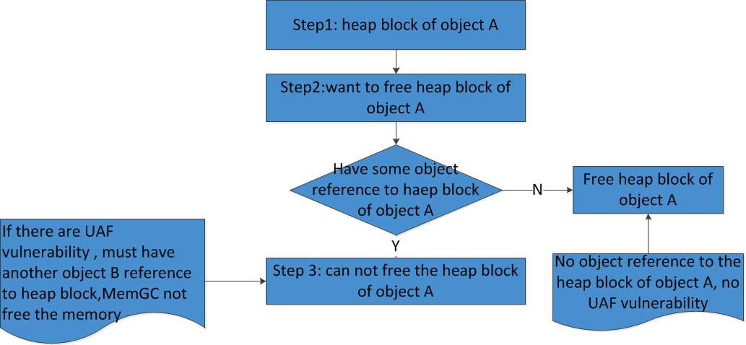
Prevent the UAF'S exploit

Slide 84
Weakness of MemGC
Conservative GC
Interior Pointer
Cross-reference in different heap
MemGC heap metadata

Slide 85
Conservative GC
MemoryProtection weakness: bypass ASLR
Yuange find the jscript9 GC infoleak vulnerability. Ga1ois first finish the poc on IE11.

Slide 86
Interior Pointer
beginaddress
Interioraddress

Slide 87
Chakra GC Interior Pointer
Interior Address >0x10000
Interior Address & 0x0f ==0
GetHeapBlock !=null
Mark
invalidBitsData
can UAF

Slide 88
MemGC Interior Pointer
Interior Address >0x10000
GetHeapBlock !=null
Mark
Realaddress =SmallHeapBlock::GetRealAddressFormInterio
validPointersBuffer
realaddress=LargeHeapBlock::GetRealAddressFormInterior
May be memory leak

Slide 89
Cross-reference in different heap
CVE-2015-2425 UAF
FREE OBJECT IN CustomHeap::Heap
reuse object in chakra GC Heap
Chakra GC
CustomHeap::Heap

Slide 90
MemGC heap metadata
LargeHeapBlock::pFreeHeapObject
LargeobjectHeader
SmallHeapBlock::pFreeHeapObject
LargeHeapBlock::pPrevFreeList
LargeHeapBlock::pNextFreeList

Slide 91
Thank you!
Any question?

